Slide 1
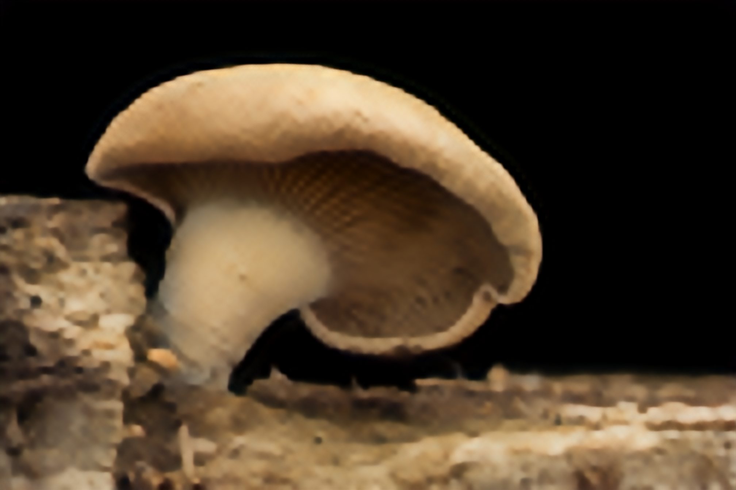
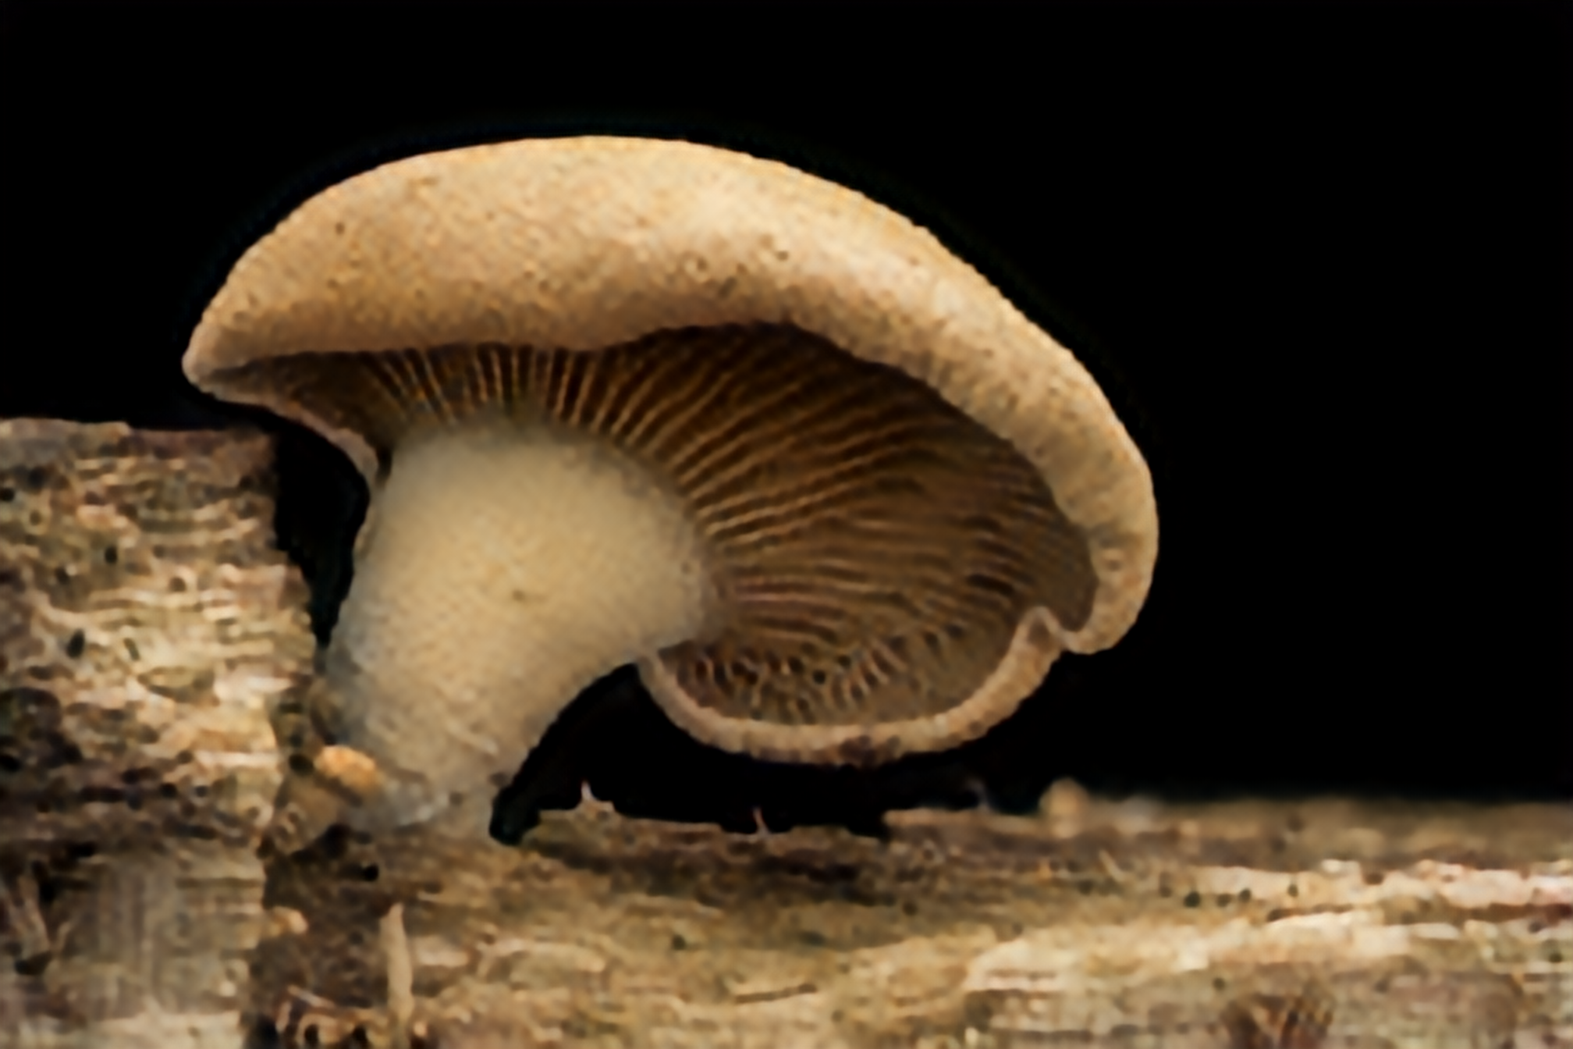
Efficient Task Aware Downscaling for Super-Resolution and Colorization
Improving Super-Resolution and Colorization in Image and Video Domain
Semester Project by Simon Schaefer
Advisor: Dr. Radu Timofte, Dr. Shuhang Gu; Supervisor: Prof. Luc Van Gool

Slide 2
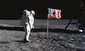
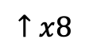
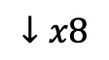
Why do we need Task Aware Downscaling ?
$$↓x8$$
$$↑x8$$
Idea: Downscale image aware of the upscaling process
so that the downscaled image still is human readable
(improve restoration quality with constant compression rate)

Slide 3
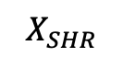
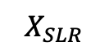
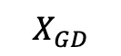
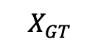
Related Work (Kim et al, ECCV‘18)
Fully-Convolutional autoencoder architecture
End-to-End trainable architecture
Proof of Concept for SISR and IC problems
$$X_{SLR}$$
$$X_{GT}$$
$$X_{SHR}$$
$$X_{GD}$$

Slide 4
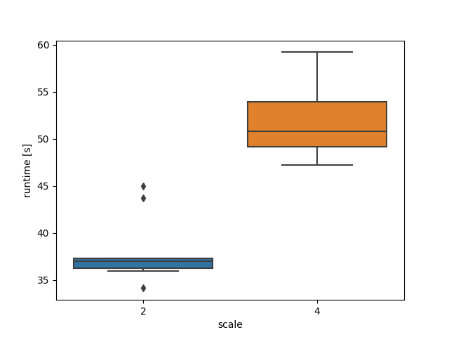
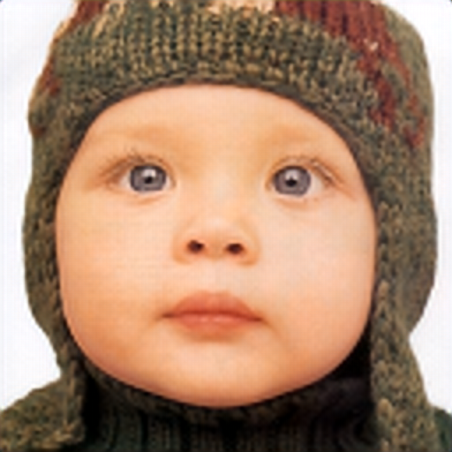
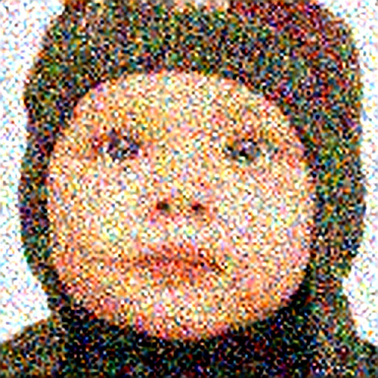
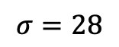
Related Work (Kim et al, ECCV‘18) - Problems
White Gaussian noise
$$σ=28$$
Very vulnerable to perturbations of the SLR image
Runtime on CPU (Mac Pro 2015)
per forward pass
Project Goals
Improve efficiency for Super Resolution and Colorization
Increase Robustness against Perturbation
Extend to Video Domain

Slide 5
General Improvements - Model
Architecture
Training
# Convolutions
and Filter Size
Totally Different Network Structure
Adaptive Learning Rate
Data Augmentation
Position of Skip Connections
Loss Weighting
# Resblocks

Slide 6
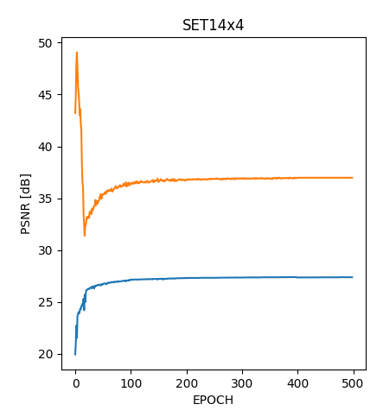
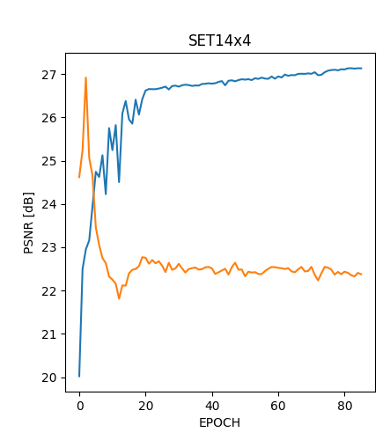
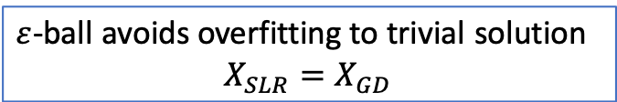


General Improvements - Loss Function
$ε=0$
$ε=50$
SHR (blue), SLR (orange)
$ε$-ball avoids overfitting to trivial solution
$$X_{SLR}=X_{GD}$$

Slide 7
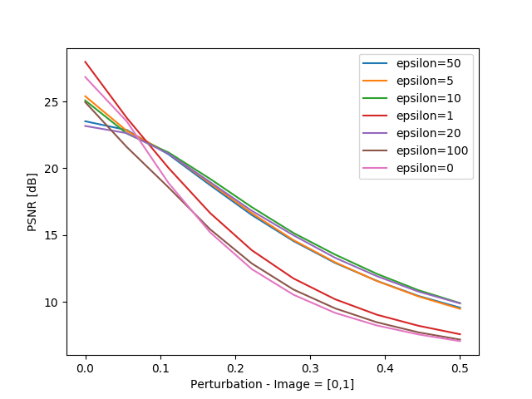
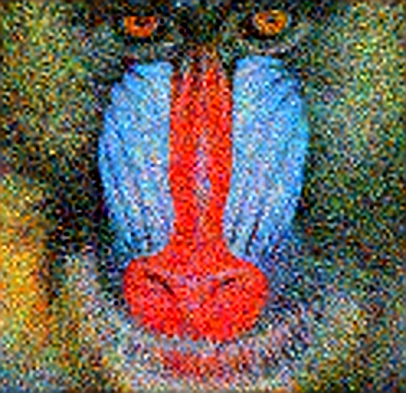
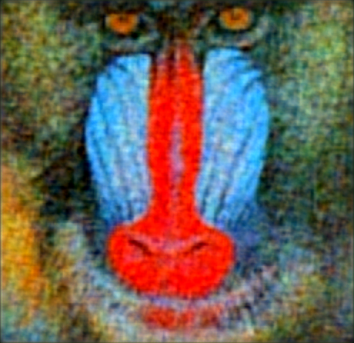
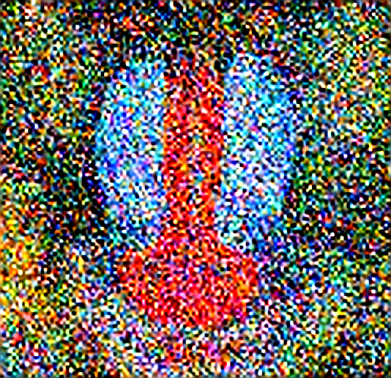
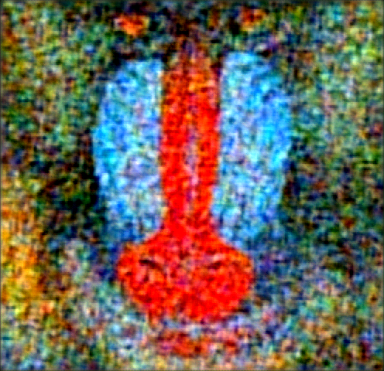
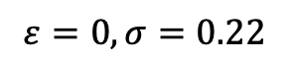
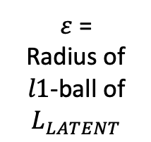
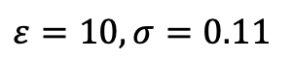
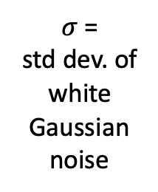
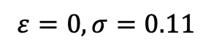
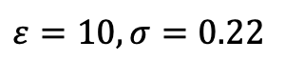
Improving Robustness against Perturbation
$σ$ =
std dev. of white Gaussian noise
$$ε=0,σ=0.11$$
$$ε=10,σ=0.11$$
$ε$ =
Radius of $l1$-ball of $L_{LATENT}$
Validation Data: Set14, Scale: 4
$$ε=0,σ=0.22$$
$$ε=10,σ=0.22$$

Slide 8

Single Image Super Resolution (SISR)
x4

Slide 9
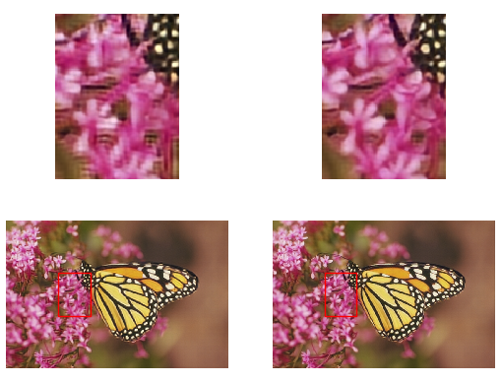
SISR – Upscaling Performance (scale = 4)
Upscale Bilinear Interpolated Image
(LR -> SHRB)
Upscaling
Task-Aware Image
(SLR -> SHRT)

Slide 10
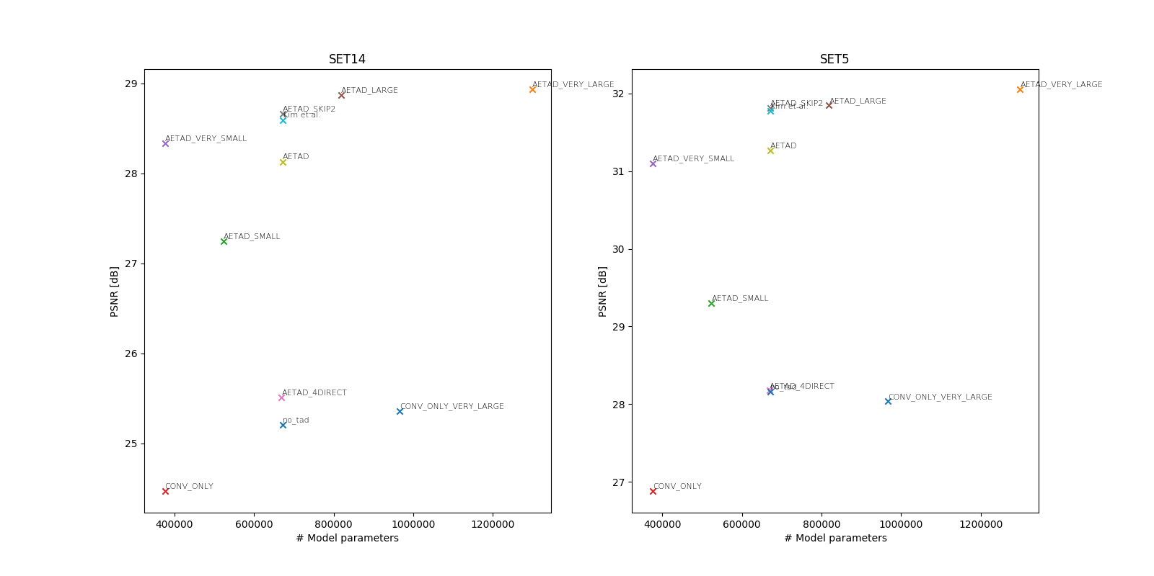
SISR - Complexity/PSNR/Robustness Tradeoff

Slide 11
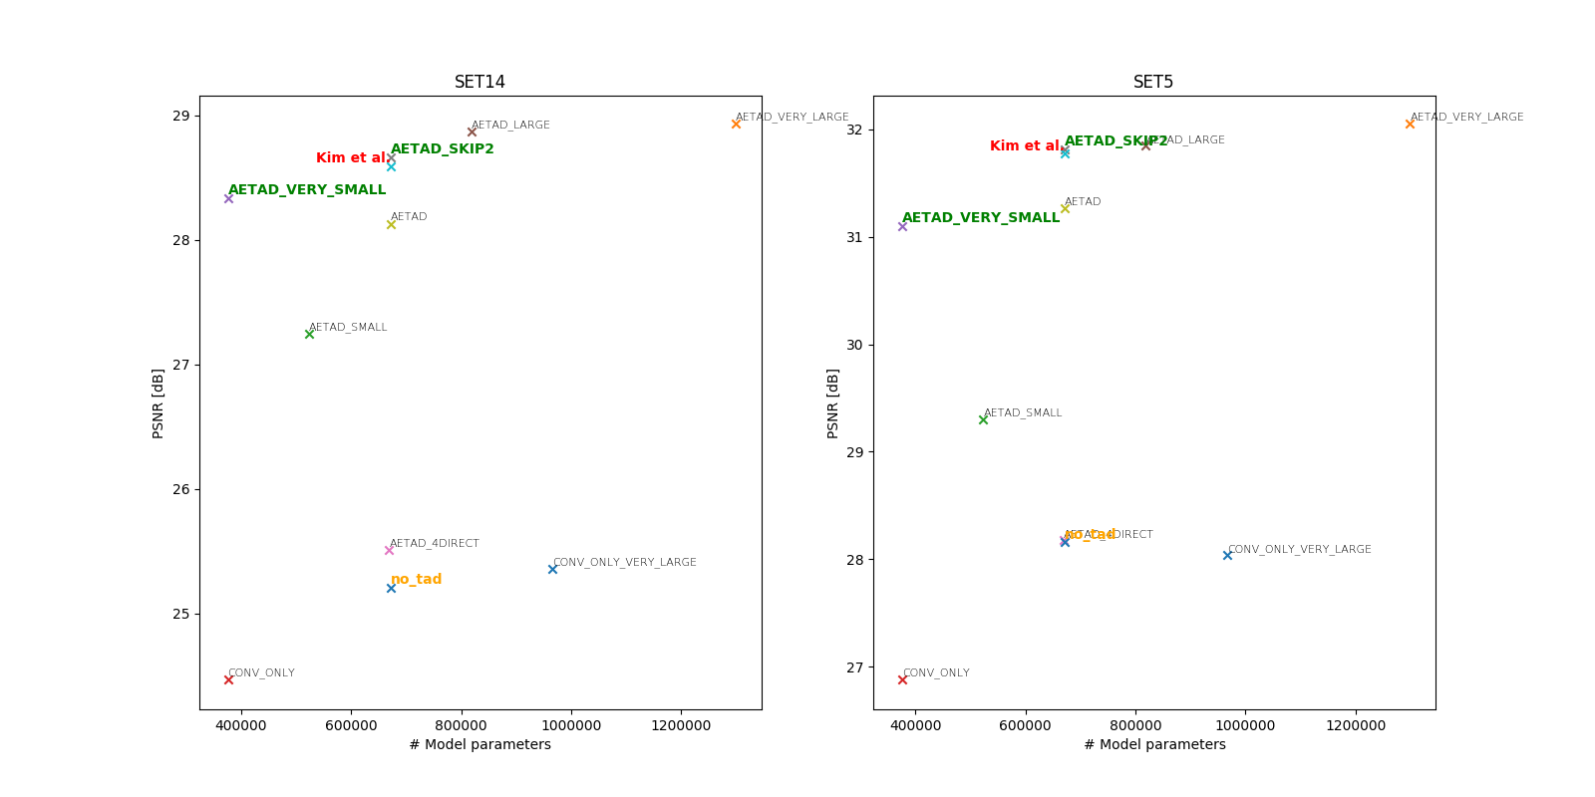
SISR - Complexity/PSNR/Robustness Tradeoff

Slide 12
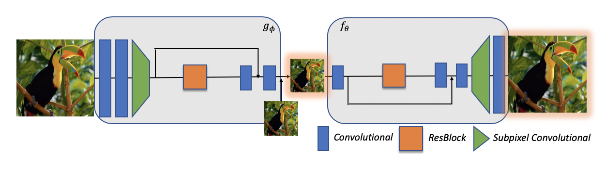
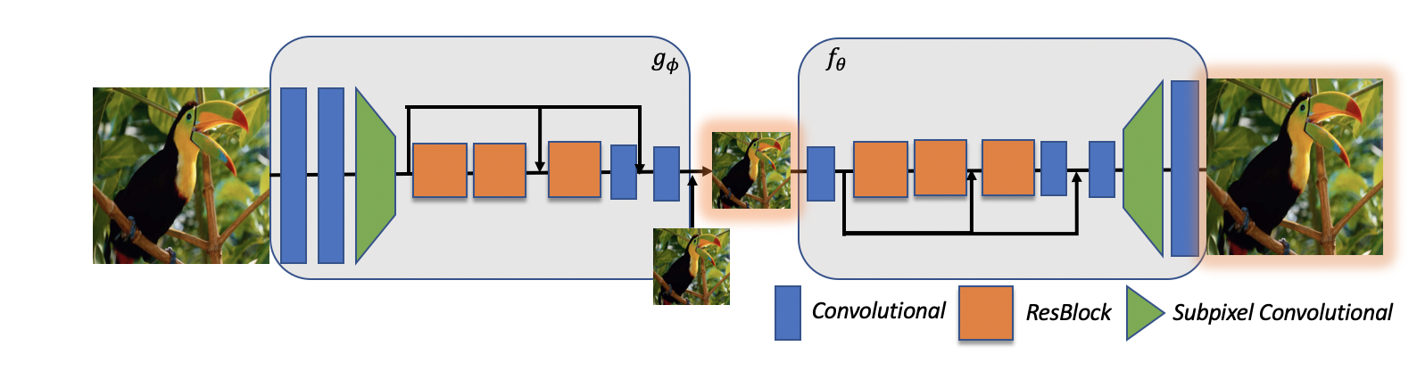
SISR - Final Model
AETAD_VERY_SMALL
AETAD_SKIP2

Slide 13
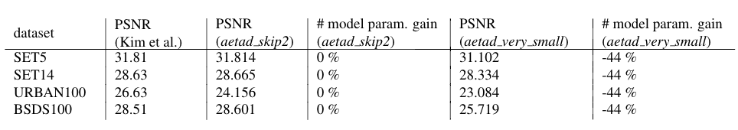
SISR - Final Model Performance

Slide 14

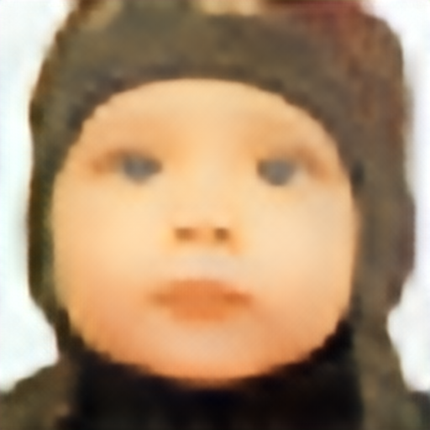
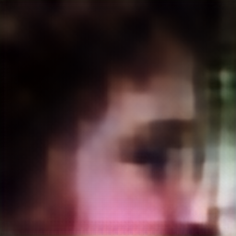
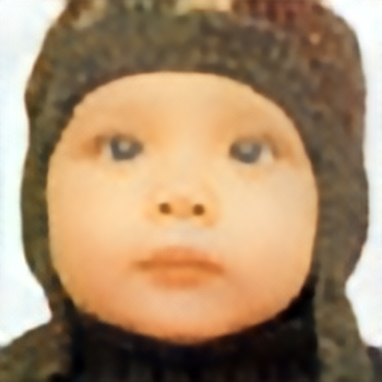
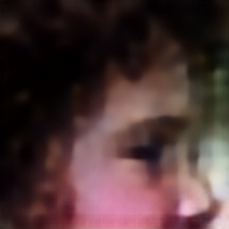
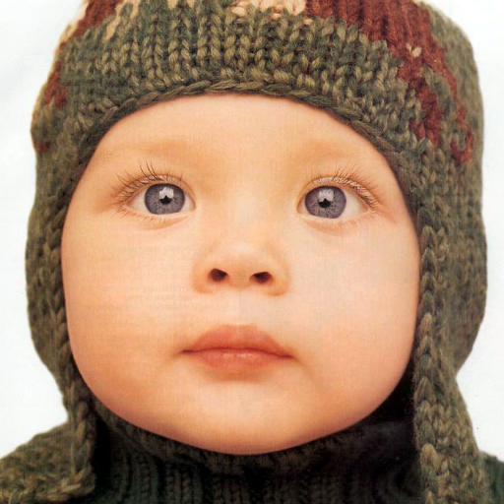
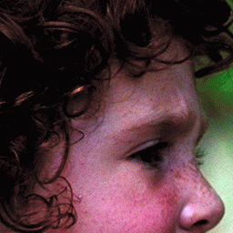
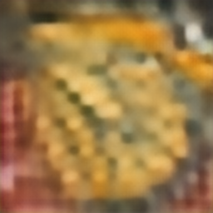
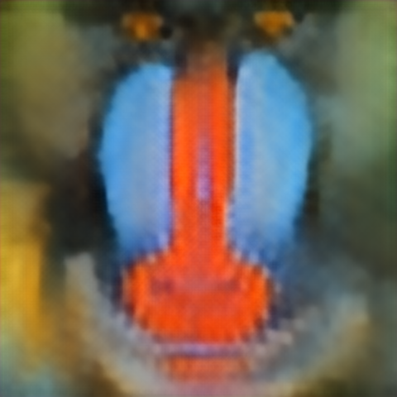
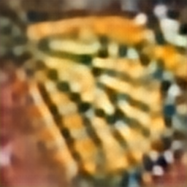
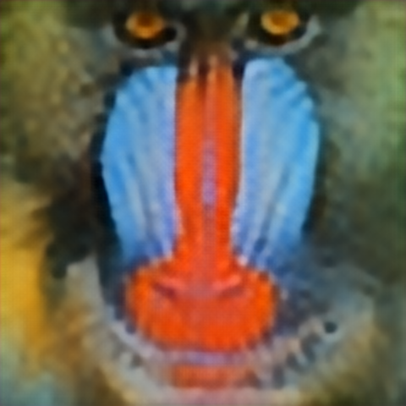
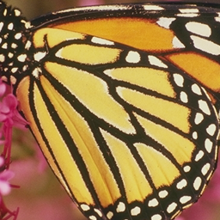
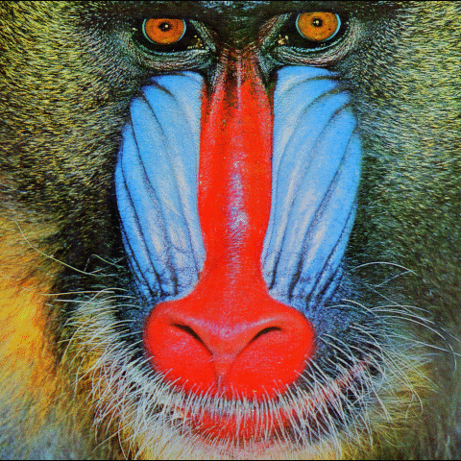
SISR – Upscaling Performance (scale = 16)
LR
Bicubic HR
TAD HR
Groundtruth HR

Slide 15
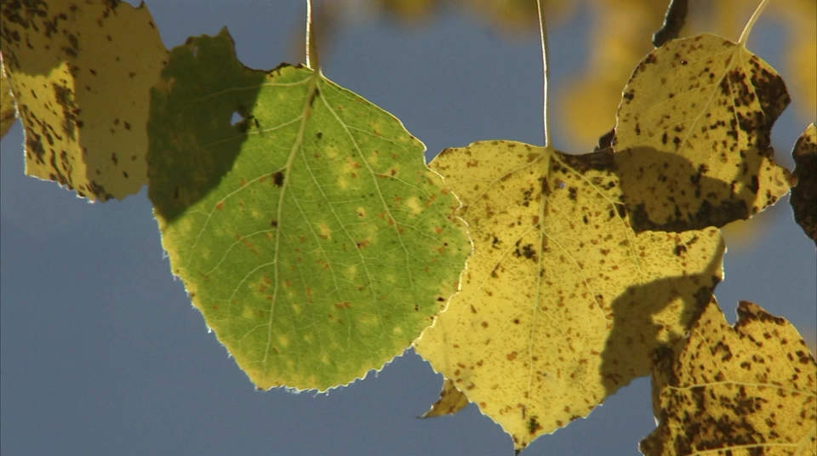
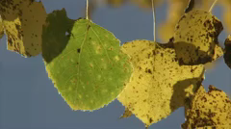
Video Super Resolution (VSR)
x4

Slide 16
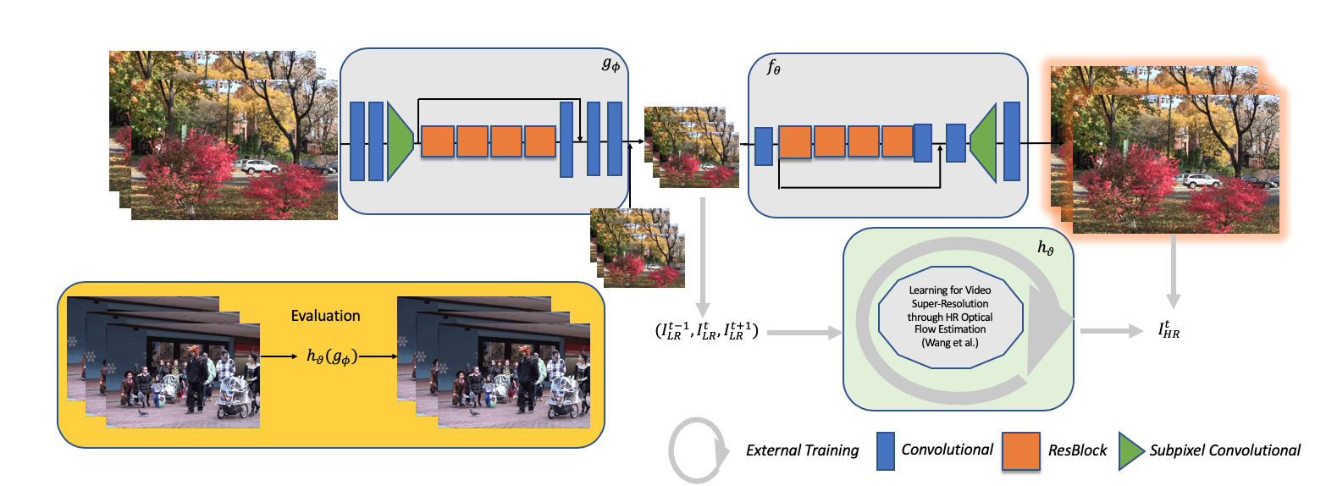
VSR – External Approach
Training:
TAD basic training (DIV2K)
TAD video training (NTIAASPEN)
SOFVSR training (NTIAASPEN_SR)

Slide 17
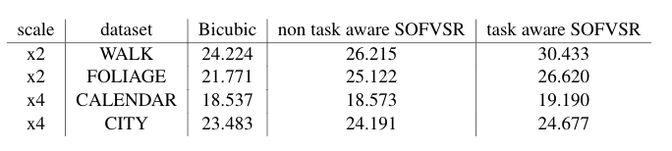
VSR - Performance

Slide 18
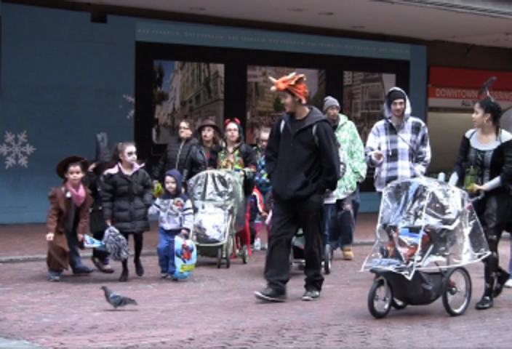

VSR – Upscaling Performance (scale = 2)
Bilinear
TAD

Slide 19

VSR – Upscaling Performance (scale = 4)
Bilinear
TAD

Slide 20


Image Colorization (IC)

Slide 21

IC - Complexity/PSNR/Robustness Tradeoff

Slide 22

IC - Final Model
AETAD_COLOR_LARGE

Slide 23

IC - Final Model Performance

Slide 24








IC – Colorization Performance
Gray
TAD Color
Groundtruth Color

Slide 25




Does TAD qualitatively outperform “classic“ approaches ?
Gray
NO-TAD Color
TAD Color
Groundtruth Color
TAD can restore images that are impossible to restore from grayscale !

Slide 26


Conclusions
Increase robustness of TAD
Extended TAD approach to video super-resolution
Improved model runtime – performance tradeoff for single image super-resolution
Improved model runtime – performance tradeoff for image colorization
Future Work
Apply purposed video super-resolution approach to other models
Deploy video super-resolution approach to even larger scale factors (> 16)
Improve compression rate of TAD

Slide 27
References
Heewon Kim, Myungsub Choi, Bee Lim, and Kyoung Mu Lee. Task-aware image downscaling. In ECCV, 2018.
Longguang Wang, Yulan Guo, Zaiping Lin, Xinpu Deng, and Wei An. Learning for video super-resolution through HR optical flow estimation. CoRR, abs/1809.08573, 2018.
Radu Timofte, Shuhang Gu, Jiqing Wu, Luc Van Gool, Lei Zhang, Ming-Hsuan Yang, Muham- mad Haris, et al. Ntire 2018 challenge on single image super-resolution: Methods and results. In The IEEE Conference on Computer Vision and Pattern Recognition (CVPR) Workshops, June 2018.
Dong C., Loy C.C., He K., and Tang X. Learning a deep convolutional network for image super resolution. ECCV 2014, 2014.
S.Schulter,C.Leistner,andH.Bischof.Fast and accurate image upscaling with super-resolution forests. pages 3791–3799, June 2015.

Slide 28
Thank you for Your Attention !
Code available on https://github.com/simon-schaefer/tar

Slide 29


Backup - Normalized Epsilon Ball
$$normalized loss= \frac{L1(X_{GD}, X_{SLR})}{{(p}_{max}−p_{min})∗p_{num}}∗100$$
$p_{max}$ = maximal pixel value
$p_{min}$ = minimal pixel value
$p_{num}$ = number of pixels
Notes:
Compression → assumption during this project, that compression rate is constant, while other performance factors (effiiciency, robustness, etc.) are improved
(BUT: LR should be human-understandable so combined autoencoder design HR – LR – LLR – LR – HR, LLR more compact representation)

Slide 30
Backup - Improving Compression Rate
Notes:
Compression → assumption during this project, that compression rate is constant, while other performance factors (effiiciency, robustness, etc.) are improved
(BUT: LR should be human-understandable so combined autoencoder design HR – LR – LLR – LR – HR, LLR more compact representation)

Slide 31





Backup – VSR Direct Approach
$$L_{TASK}=L1(X_{GT}, X_{EXTERNAL})$$

Slide 32



Backup – VSR Flow Approach
$L_{TASK}=L1(X_{FLOW_GT}, X_{FARNEBACK})$ + $L1(X_{GT}, X_{SHR})$
UCL Optical Flow Dataset
Notes:
One approach that was tried in order to apply \ac{TAD} on \ac{VSR} was to find a low-dimensional representation that is optimal to reconstruct the optical flow. \myfigref{fig:architecture_video_flow} indicates the design for this approach, which was trained using the UCL optical flow dataset (\cite{ADAEMFOF}) and the OpenCV Farneback dense optical flow function (since easily available for a conceptual test). Unfortunately, the approach did not converge to useful representation. Since other approaches could successfully solve the \ac{VSR} task this approach was discarded.

Slide 33
Backup – SOFVSR Selection
Performance and Closeness to state-of-the-art
Availability of PyTorch implementation open-source
According to website PapersWithCode comparing stated results of papers in standard computer vision problems

Slide 34
Backup – Limitations of TAD
Increased computations compared to trival downscaling
Larger vulnerability against perturbations
Notes:
Compression → assumption during this project, that compression rate is constant, while other performance factors (effiiciency, robustness, etc.) are improved
(BUT: LR should be human-understandable so combined autoencoder design HR – LR – LLR – LR – HR, LLR more compact representation)

Slide 35










Backup – Large Perturbation
$$ε=10$$
$$ε=0$$
$$e=0.11$$
$$e=0.22$$
$$e=0.39$$
$$e=0.50$$

Slide 36

Backup – SISR PSNR for scale = 16

